Slide 1

Arrays
Prepared and presented by - Naomi Padmore

Slide 2
Arrays
Fifth Element
First Index
0 | 1 | 2 | 3 | 4 | 5 | 6
arr[0] | arr[1] | arr[2] | arr[3] | arr[4] | arr[5] | arr[6]
An array is a collection of elements of the same data type
Example of an array ‘arr’, with a length of 7

Slide 3
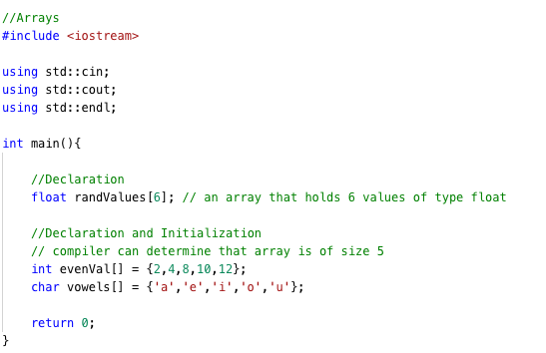
Declaration and Initialization

Slide 4
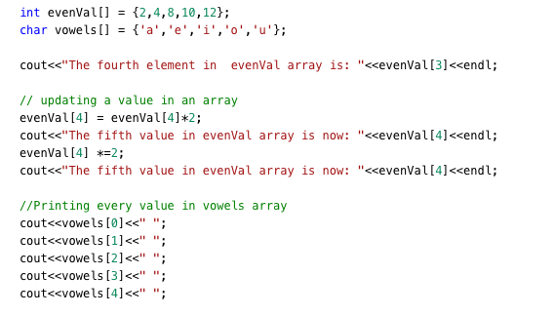
Operations on Arrays

Slide 5
2D Arrays
 | Column 0 | Column 1 | Column 2 | Column 3
Row 0 | arr[0][0] | arr[0][1] | arr[0][2] | arr[0][3]
Row 1 | arr[1][0] | arr[1][1] | arr[1][2] | arr[1][3]
Row 2 | arr[2][0] | arr[2][1] | arr[2][2] | arr[2][3]
arr[1][1]
A two-dimensional array is an array of one-dimensional arrays
Example of a (3x4) two-dimensional array ‘arr’

Slide 6
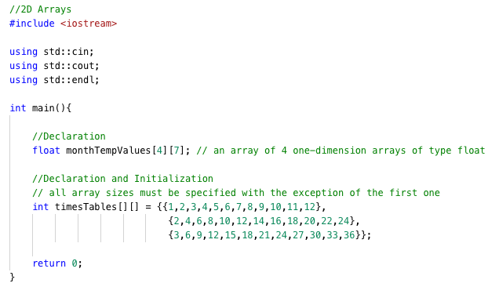
Declaration and Initialization of a 2D array

Slide 7
Food for thought
Use a for or while loop to initialize an array and then print the values in the array using another loop

Slide 8
That’s All

